Slide 1
The type of number

Slide 2
a = 15

Slide 3
a = 1.5

Slide 4
a = 30000000000

Slide 5
a = 30_000_000_000

Slide 6
a = 300_0000_0000

Slide 7
a = 3000_00_0_000_0

Slide 8
a = 300000_0__000_0
X

Slide 9
a = 3 + 2j

Slide 10
a = 3.5+2.5j

Slide 11
a = .5

Slide 12
a = .0

Slide 13
a = 0.

Slide 14
.0 == 0.0 == 0.

Slide 15
a = .
X

Slide 16
a = 0000

Slide 17
a = 00100
X

Slide 18
a = .000

Slide 19
a = 000.

Slide 20
a = 000.000

Slide 21
a = 1*10**5
float!!!
a = 10 = 100000
5

Slide 22
a = 1e5
float!!!
5个0
a = 10 = 100000
5

Slide 23
a = AeB
B
A x 10
↑整数

Slide 24
a = 1e-3
float!!!
3位
a = 10 = 0.001
-3

Slide 25
a = .5e.1
a = 4e5+3e1j

Slide 26




1.7e308 double类型最大值
-323
15
308
量变引起质变
精度限制
精度损失

Slide 27
a = 1

Slide 28
a = -1

Slide 29
a = +1

Slide 30
a = ++1

Slide 31
a = +++1

Slide 32
a = +++++++++++++1

Slide 33
a = --------------1

Slide 34
a = -+-+-+-+-+-+-+1

Slide 35
a = -.5

Slide 36
a = ----.0

Slide 37
a = 0xabcdef

Slide 38
a = 0b101010

Slide 39
a = 0o777777

Slide 40
a = -0xf

Slide 41
a = --+-0xf

Slide 42
a = -0b11.11
X

Slide 43
a = 0xff_aa_f1

Slide 44
a = 0xfff + 0b111j

Slide 45
迷惑同学 迷惑老师 防止雷同代码

Slide 46
infinity
float(“inf”)

Slide 47
∞
float(“INF”)

Slide 48
∞
float(“Inf”)

Slide 49
∞
float(“inF”)

Slide 50
-∞
-float(“inF”)

Slide 51
-∞
float(“-inf”)

Slide 52
-∞
type(float(“-inf”)) == float

Slide 53
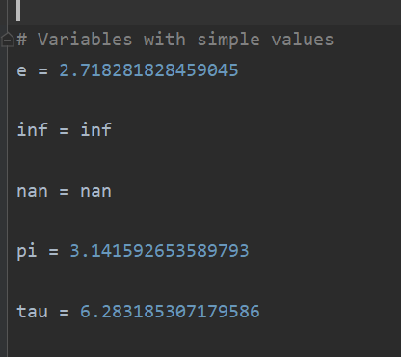
import math

Slide 54
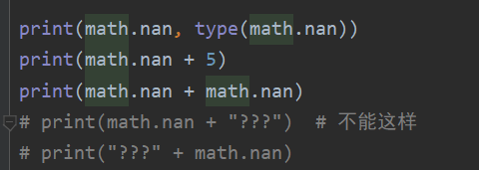
NaN

Slide 55
float(“inf”) == math.inf
>>> True
float(“inf”) is math.inf
>>> False

Slide 56
arr = [
math.inf, math.inf,
float("INF"), float("inF"),
-float(“-INF")
] print("----") for obj in arr: print("\t", id(obj)) print("----")
----
2361443791640
2361443791640
2361443791880
2361443791904
2361443791952
----
Math的更省空间

Slide 57
float("INF") == float("INF") + 1

Slide 58
















Slide 59










>>> e**float("-INF")
0.0
>>> e**float("INF")
inf
>>> e**float("INF") == pi**float("INF")
True
>>> e**float("INF") is pi**float("INF")
False
>>> math.exp(float("INF"))
inf
>>> math.exp(float("inf")) == math.log(float("inf"))
True
>>> math.exp(float("inf")) is math.log(float("inf"))
False
>>> math.exp(float("INF")) is e ** float("INF")
False
>>> e ** float("INF")
inf

Slide 60














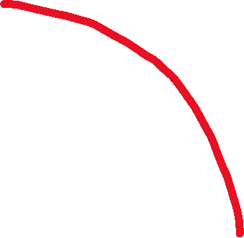


Slide 61
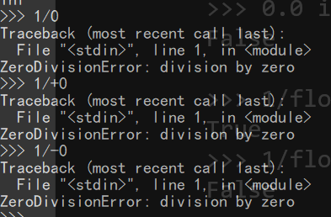
>>> 1/float("INF")
0.0
>>> 1/float("-inf")
-0.0
>>> 0.0==-0.0
True
>>> 0.0 is -0.0
False
>>> 1/float("INF") == 1/float("-INF")
True
>>> 1/float("INF") is 1/float("-INF")
False

Slide 62
>>> 0.0==-0.0
True
>>> 0.0 is -0.0
False
>>> 0 is 0
True
>>> 0 is -0
True
>>> 0.0 is 0.0
True
>>> 0.0 is 0000.000
True
>>> 0.0 == 0
True
>>> 0.0 is 0
False
>>> 1e-1000 == 0
True
>>> 1e-1000 is 0
False
>>> 1e-1000 == 1e-500
True
>>> 1e-1000 is 1e-1000
True
>>> 1e-1000 is 1e-999
True
>>> 1e1000 is 1e500
True

Slide 63
应用环节

Slide 64
arr = [1, 2, 4, 7, 2, 6, 2, 5] res = float("-INF") for i, n in enumerate(arr): if n > res: res = n print(res)

Slide 65



leetcode第79场双周赛 第二题
class Solution: def largestWordCount(self, messages: List[str], senders: List[str]) -> str: userWords = {} for i, user in enumerate(senders): n = len(messages[i].split()) if user not in userWords: userWords[user] = n else: userWords[user] += n maxVal = -float("INF") for k, v in userWords.items(): if v > maxVal: maxVal = v lst = [] for k, v in userWords.items(): if v == maxVal: lst.append(k) lst.sort(reverse=True) return lst[0]

Slide 66





leetcode第 295 场周赛 第一题
class Solution: def rearrangeCharacters(self, s: str, target: str) -> int: c1 = Counter(s) c2 = Counter(target) minRate = float("INF") for k, v in c2.items(): if k not in c1: return 0 for k, v in c2.items(): rate = c1[k] / v minRate = min(rate, minRate) return int(minRate)

Slide 67




Leetcode minimumTotal 动态规划题
class Solution: def minimumTotal(self, triangle: List[List[int]]) -> int: def safeGet(xIndex, yIndex): # try: # return triangle[yIndex][xIndex] # except IndexError: # return float("INF") # -1 给转化成倒数第一个元素了！！！ if yIndex not in range(len(triangle)): return float("INF") if xIndex not in range(yIndex + 1): return float("INF") return triangle[yIndex][xIndex] for y, line in enumerate(triangle): if y == 0: continue for x, n in enumerate(line): line[x] = min(safeGet(x, y - 1), safeGet(x - 1, y - 1)) + n return min(triangle[-1])

Slide 68





Leetcode maxPathSum
class Solution: def __init__(self): self.maxSum = float("-inf") def maxPathSum(self, root: TreeNode) -> int: def maxGain(node): if not node: return 0 # 递归计算左右子节点的最大贡献值 # 只有在最大贡献值大于 0 时，才会选取对应子节点 leftGain = max(maxGain(node.left), 0) rightGain = max(maxGain(node.right), 0) # 节点的最大路径和取决于该节点的值与该节点的左右子节点的最大贡献值 priceNewpath = node.val + leftGain + rightGain # 更新答案 self.maxSum = max(self.maxSum, priceNewpath) # 返回节点的最大贡献值 return node.val + max(leftGain, rightGain) maxGain(root) return int(self.maxSum)

